Slide 1

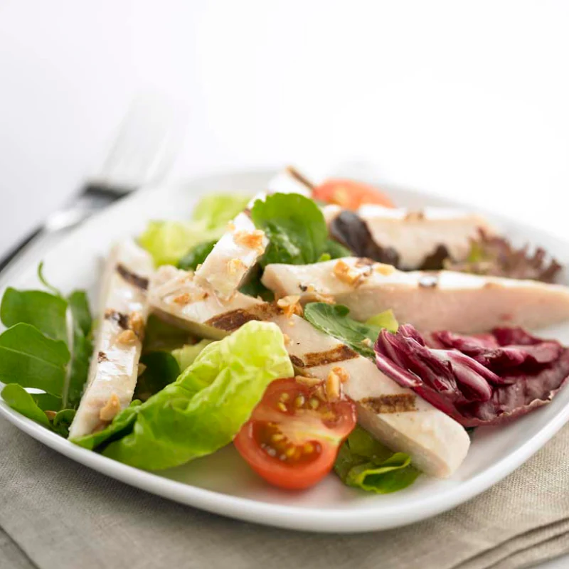
Leading the Frozen Food Revolution: CS Tay's Journey to Healthier, Convenient, and Delicious Choices
Date: 31 Aug 2024
Presented by: Wave 15 BDA Group 7

Slide 2

Agenda
Executive Summary
Customer Segmentation
Methodology
Price Elasticity
Methodology
Data Visualisation
Forward Looking Map
Q&A
Appendix
Data Preparation

Slide 3

Executive Summary
Executive Summary
Customer Segmentation
Conclusion
Forward Looking Map
Price Elasticity
Data Visualization
Situation
CS Tay, Singapore's leading frozen product seller, is experiencing rapid growth. The company specializes in healthier, convenient, and delicious frozen foods, including poultry, seafood, vegan items, and sausages. As part of its expansion strategy, CS Tay aims to refine its customer segmentation and pricing strategy for the top 10 SKUs across various customer segments and product categories.
Problem
CS Tay faces challenges understanding customer profiles and managing competitive price fluctuations. These issues have made it difficult for the company to leverage historical sales data for predicting customer segments and optimizing pricing strategies, impacting its ability to maximize revenue.
Solution [need to edit]
A data-driven approach will be implemented to segment customers based on purchase patterns and develop an optimal pricing strategy for critical SKUs. By analyzing historical sales data, CS Tay can gain insights into customer behavior and price sensitivity, enabling more targeted marketing and informed pricing decisions.
Impact [need to edit]
This strategy, once implemented, will bring about a wave of positive changes. It will enhance customer satisfaction and loyalty, improve profitability through optimized pricing, and support CS Tay's growth. Ultimately, it will strengthen the company's market position and align with its vision of offering healthier, convenient, and delicious foods.

Slide 4
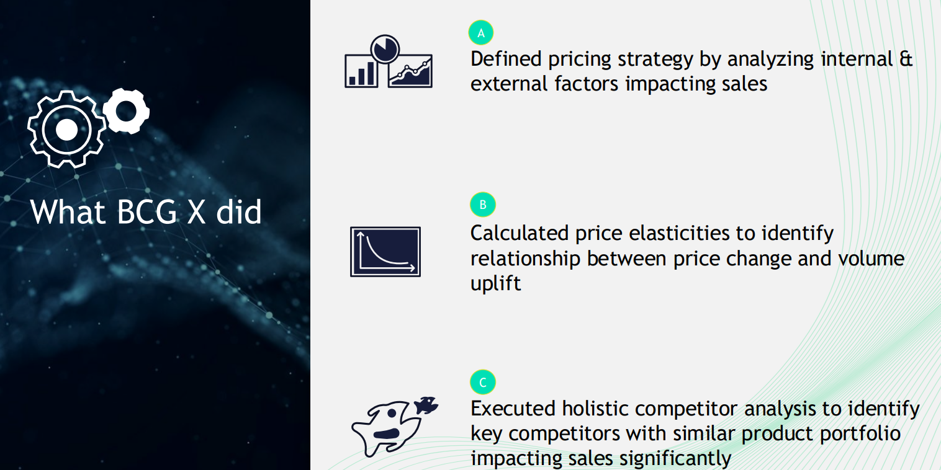
Problem statement / Business challenge

Slide 5

Business challenge
Challenges in Understanding Customer Profiles
Difficulty Managing Competitive Price Fluctuations
Inability to Leverage Historical Sales Data
Impact on Revenue Optimization
Notes:
Challenges in Understanding Customer Profiles: CS Tay struggles to accurately identify and segment its customers.
Difficulty Managing Competitive Price Fluctuations: The company finds it challenging to adjust pricing in response to market competition.
Inability to Leverage Historical Sales Data: CS Tay is unable to effectively use past sales data to predict customer segments and behavior. ( a need to understand historical sales data, sales trend analysis, understanding forecast and impact on revenue optimization)
Impact on Revenue Optimization: These issues hinder the company’s ability to optimize pricing strategies and maximize revenue.

Slide 6
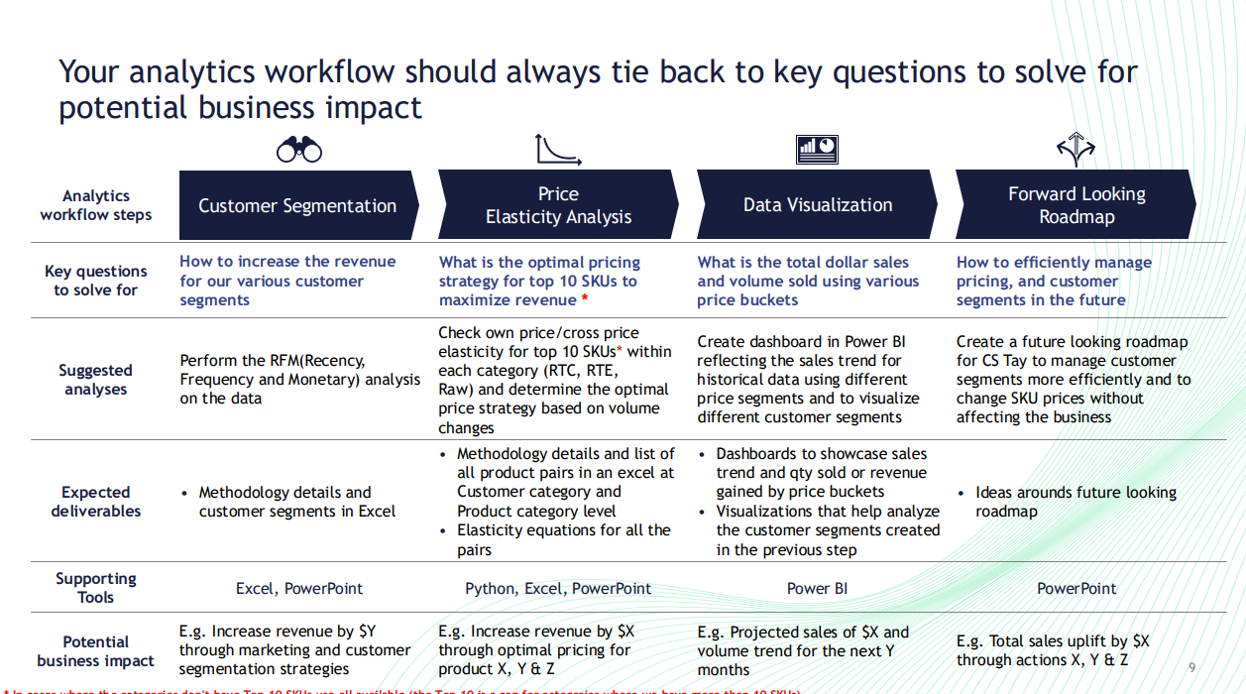

Slide 7
What our Team did
To define customer segments by analyzing historical transaction data using RFM and K-means
Determine own and cross price elasticities to identify the relationship between SKU from Supermarket and Retail category
Implemented model to determine the optimal price and volume adjustments for SKUs that maximize total revenue.
Via Data visualizations ??
Notes:
When we define customer seg, it is to increase

Slide 8
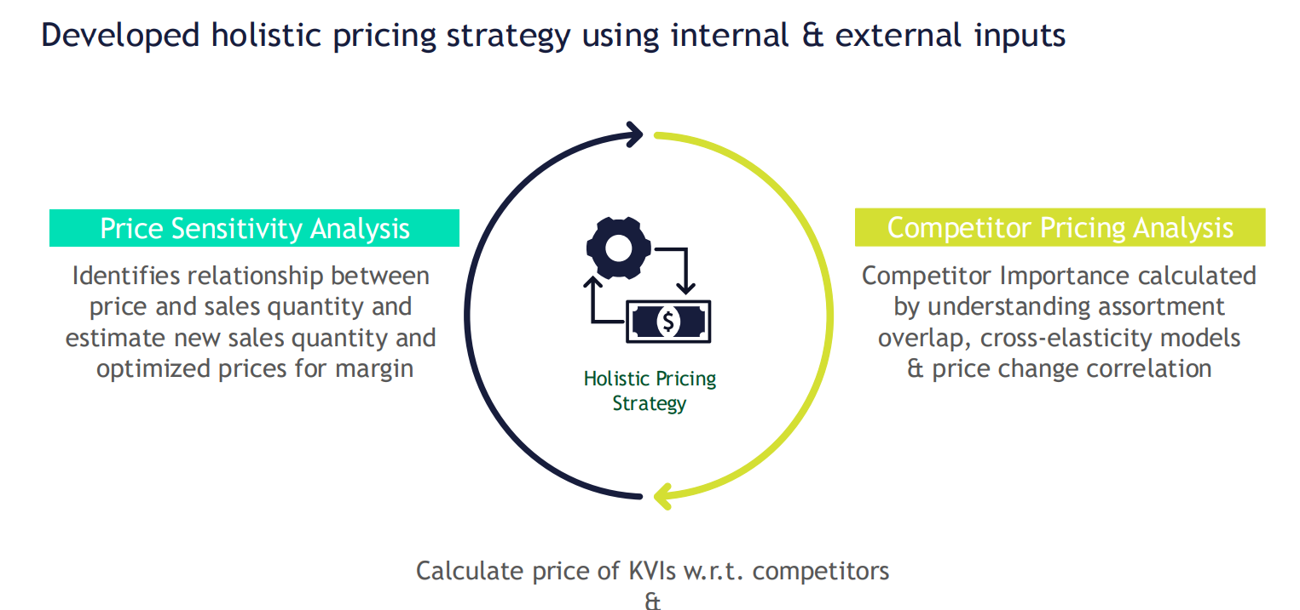
Our approach

Slide 9
Our approach
Customer Segmentation
Perform customer segmentation using Recency, Frequency and Monetary (RFM) analysis with K-means clustering
Price Elasticity Analysis
Created optimization model using Gurobi to determine the optimal price adjustments for SKUs that maximize total revenue.

Slide 10
Methodology for Data Processing and Analysis
Data Loading
Loaded initial dataset into aggregated_df.
Data Inspection
Reviewed structure, data types, and identified anomalies (e.g., Transaction Date, Sales Order No., etc.).
Data Cleaning & Transformation
Converted data types, corrected inconsistencies (e.g., Customer Name), and created new columns (Customer Category Broad, Item Category).
Memory Optimization
Converted columns to category data type to reduce memory usage.
Final Data Inspection
Verified all transformations and ensured data readiness.
Export Processed Data
Exported cleaned DataFrame (aggregated_df.csv, no_customer_name_agg_df.csv).

Slide 11
Methodology for Customer Segmentation Using RFM Analysis and K-Means Clustering
Data Preparation
Segmentation
RFM segmentation
Optimization of revenue for Supermarket & Retail category individually
Dashboarding
Visualizing the different customer segments
Sales trends for historical data
Price Elasticity Analysis
K-Means Clustering
Finding the intersactions
Finding own and cross price elasticity for Top 10 SKU
Sales forecast
Forward Looking Map
Strategies to manage customer segments
Strategies to manage pricing for Top SKUs
Notes:
Put this to Appendix
Only show headers

Slide 12
Methodology for Customer Segmentation Using RFM Analysis and K-Means Clustering
Data Preparation
Feature Selection: Chose key features (Recency, Frequency, Monetary, Total Quantity).
Data Scaling: Applied RobustScaler to normalize the data.
RFM Segmentation
RFM Scoring: Assigned scores for Recency, Frequency, Monetary values.
Segment Assignment: Mapped customers to segments (e.g., Champions, Loyal Customers).
K-Means Clustering
First Run: Identified optimal clusters (3) using Elbow and Silhouette methods.
Second Run: Further segmented Cluster 1 into sub-clusters.
Integration
Merging Segments: Combined RFM segments with K-Means clusters.
Crosstab & Visualization: Analyzed customer distribution with heatmaps.
Category Analysis
Customer & Item Categories: Grouped and visualized data to explore segment distribution.
Exporting Results
CSV Export: Final segmented data exported for further analysis.
Notes:
Put this to Appendix
Only show headers

Slide 13
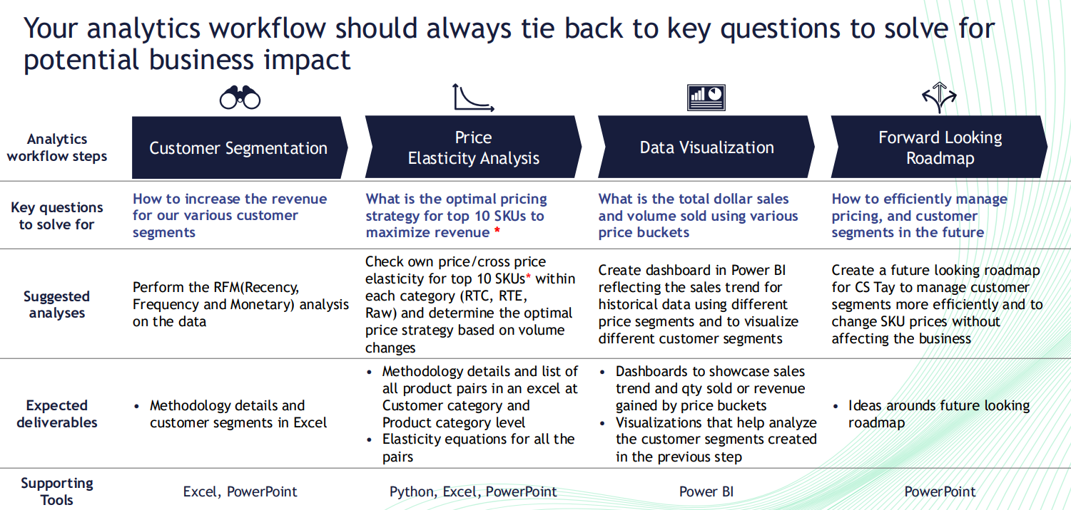

Slide 14
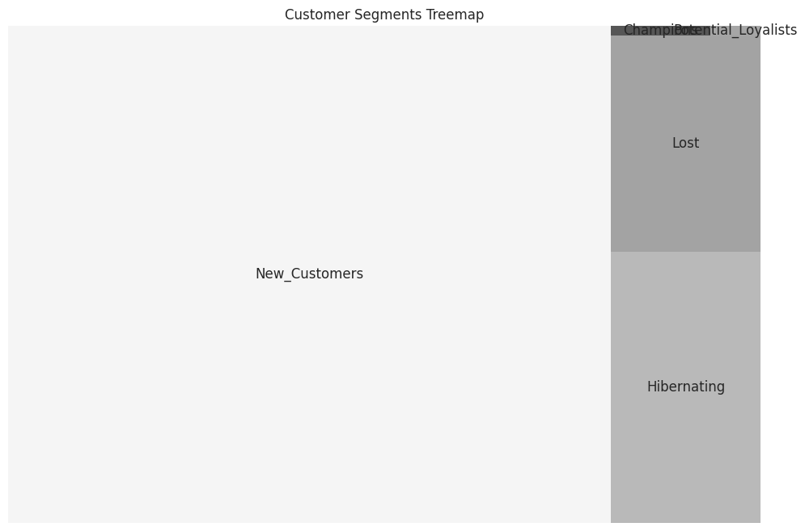
Recommended number of segments based on analysis
Segmented based on RFM
Recency
Frequency
Monetary
Define the 5 customer segments
Champion
Loyal and high-value customers who purchase frequently and recently.
Hibernating
Customers who have become inactive and haven't purchased recently.
Lost
Former customers who haven't purchased in a long time and may not return.
New Customers
Recently acquired customers with potential but not yet fully loyal
Potential Loyalists
Customers showing signs of loyalty through repeat purchases but not yet top-tier.
Notes:
Here are the definitions for the 5 customer segments:
Champion
Description: These are your best customers who have purchased recently, frequently, and have spent a significant amount. They are loyal and engaged with your business.
Characteristics:
High frequency of purchases.
Recent purchase activity.
High monetary value of transactions.
Strategy: Reward them with exclusive offers, loyalty programs, or personalized experiences to maintain and strengthen their loyalty.
Hibernating
Description: These customers used to be active but have not engaged with your business recently. They may need a reminder or re-engagement to come back.
Characteristics:
Low frequency of recent purchases.
Longer time since last purchase.
Moderate to low monetary value.
Strategy: Send re-engagement campaigns, reminders, or special offers to encourage them to return.
Lost
Description: These are customers who were once active but have not made any purchases in a long time. They may have moved on to competitors or no longer need your products.
Characteristics:
Very low or no recent purchase activity.
High recency since last purchase.
Low or no monetary value.
Strategy: Attempt to win them back with targeted win-back campaigns, or consider removing them from active marketing lists if they are unresponsive.
New Customers
Description: These are customers who have recently made their first purchase. They have potential but are not yet fully loyal.
Characteristics:
Recent first-time purchase.
Low frequency of purchases.
Moderate monetary value.
Strategy: Nurture these customers with onboarding programs, educational content, and offers to encourage repeat purchases and build loyalty.
Potential Loyalists
Description: These customers show signs of becoming loyal but aren't quite there yet. They are making repeat purchases but haven't reached the frequency or value of your top customers.
Characteristics:
Frequent but not top-tier purchasing activity.
Recent engagement.
Moderate to high monetary value.
Strategy: Encourage more frequent purchases and higher spending with targeted promotions, incentives, and personalized experiences.

Slide 15
Customer segments using RFM analysis
Champion
Loyal and high-value customers who purchase frequently and recently.
Hibernating
Customers who have become inactive and haven't purchased recently.
Lost
Former customers who haven't purchased in a long time and may not return.
New Customers
Recently acquired customers with potential but not yet fully loyal
Potential Loyalists
Customers showing signs of loyalty through repeat purchases but not yet top-tier.
Notes:
Show visuals

Slide 16
Marketing strategies for customer segments

Slide 17
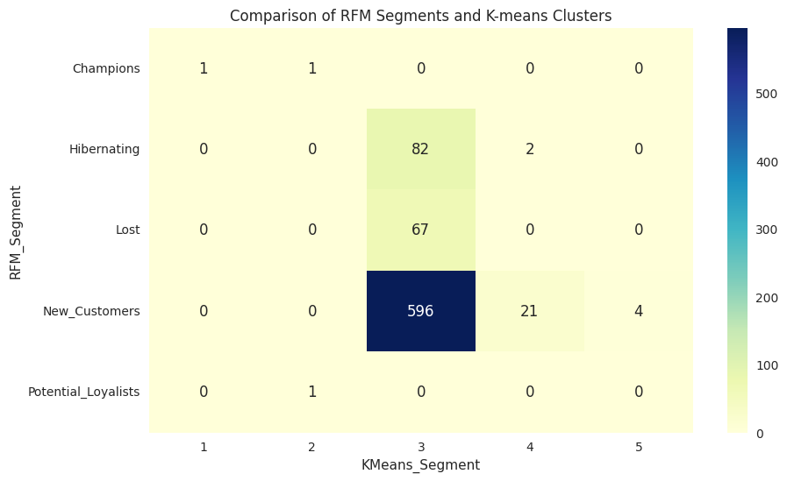
Notes:
Visuals based on powerbi

Slide 18
Top 10 SKUs for Supermarket & Retail Category by Raw, RTE, RTC

Slide 19
Optimised Price
Top drivers of revenue
So as to address frequent price changes across SKUs
Resulting in revenue growth of

Slide 20
Example product pair on elasticity

Slide 21
Appendix: List of all product pairs at Cust Category and Product Category level
Notes:
Appendix

Slide 22
Appendix: Methodology for Price Elasticity Analysis and Optimization
Price Elasticity Calculation
Data Preparation: Merged SKUs and calculated individual and cross-price elasticities.
Elasticity Metrics: Determined price sensitivity (elastic/inelastic demand) using the elasticity formula.
Revenue Optimization
Model Setup: Created a Gurobi optimization model to adjust prices and maximize total revenue.
Revenue Function: Built a function accounting for own-price and cross-price elasticities, ensuring positive quantities.
Execution & Analysis
Optimization: Executed the model to find optimal price adjustments.
Result Analysis: Assessed the impact of price changes on revenue.
Customer Category Optimization
Category-Specific Models: Performed optimization for each customer category (e.g., Supermarket, Retail).
Result Aggregation: Compared revenue impacts across categories.
Data Export
CSV Export: Final optimized data exported for further analysis.
Notes:
Create link in main slide to link to this slide

Slide 23
Key data elements used in price elasticity
Focused on customer segments – Supermarket & Retail
Merge relevant SKU into pairs from Supermarket and Retail segments in each category (RTC, RTE, Raw) for comparison.
SKU A & SKU B
Price Elasticity SKU A & SKU B
Cross Price Elasticity
Optimal Price
Quantity Demanded per SKU
Customer Category
Build a revenue function that accounts for both own-price elasticity and cross-price elasticity, ensuring non-negativity constraints on quantities.
Calculate the price elasticity of demand for each SKU and the cross-price elasticity between paired SKUs
Create an optimization model using Gurobi to determine the optimal price adjustments for SKUs that maximize total revenue.
Measured the impact of a price change in SKU A on the quantity demanded for SKU B, and vice versa.

Slide 24
Comparison between own price and cross price elasticity.

Slide 25
Data Visualizations
Show Sales Trend and Qty sold/revenue gained by price buckets
Visualisations to analyze cust segments

Slide 26
Forward Looking Map
Highlight on New Customers (contributing 44% of the total)
Eg. Loyalty program
Tier 1: Champion
VIP treatment
Recommend to use optimised prices to max revenue. Est 4mil revenue increase
Tier 2: Potential Loyalist
Tier 3: New Customer
Special loyalty program to keep them purchasing
Tier 4: Hibernating & Lost
Understanding why they left

Slide 27
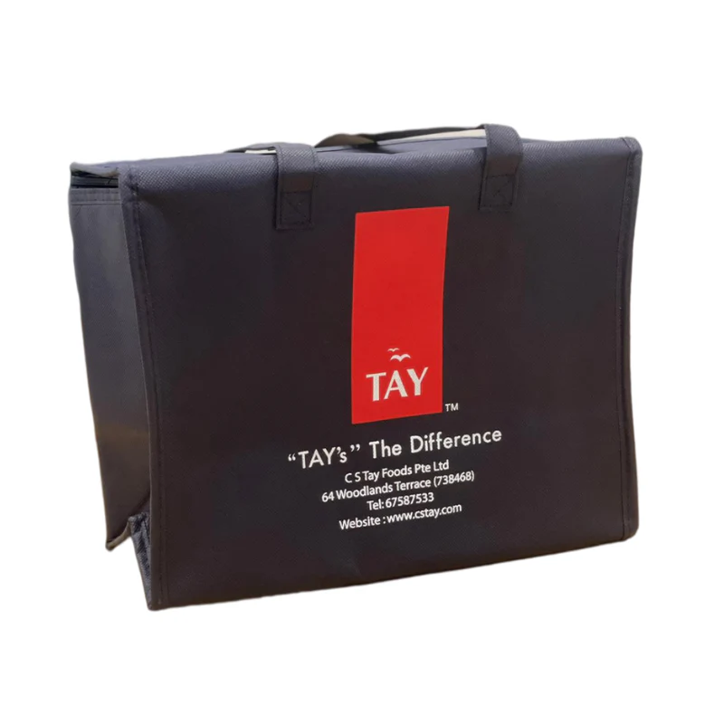
Q&A

Slide 28
Reference
Photos and Logo: https://www.cstay.com/

Slide 29
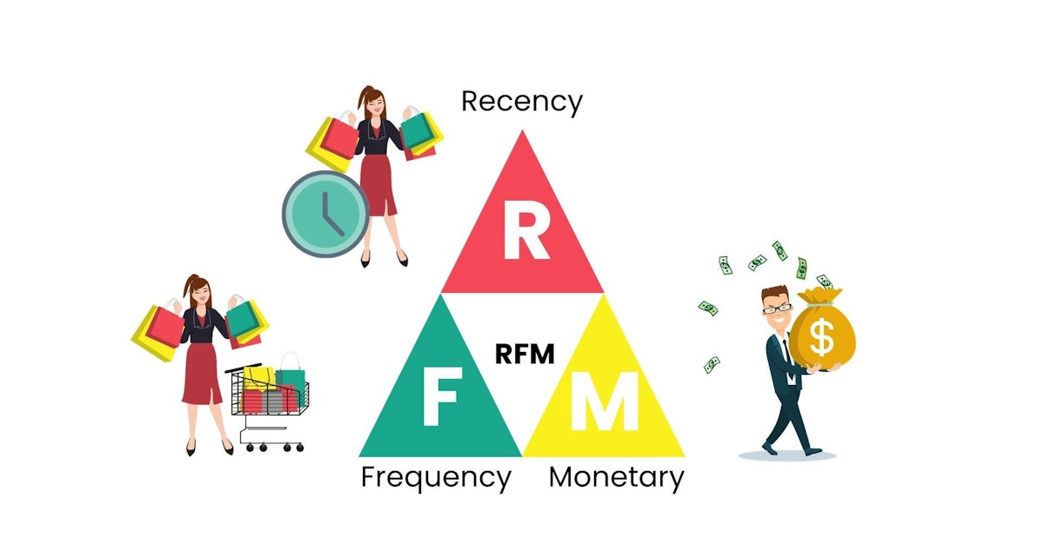
What is RFM?
Recency measures the number of days since a customer's last purchase, indicating how recently they have engaged with the business.
Frequency refers to the total number of transactions a customer has made, showing how often they engage with the business.
Monetary measures the total value of a customer's transactions, indicating how much they spend with the business.
RFM graphic source: https://hackernoon.com/what-is-rfm-recency-frequency-monetary-analysis

Slide 30
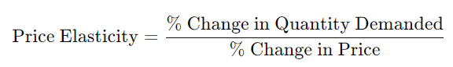
What is Own Price Elasticity?
Own price elasticity measures how the quantity demanded of a product changes in response to a change in its own price.

Slide 31
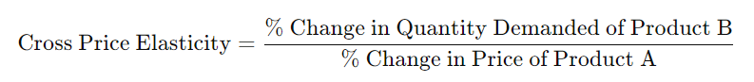
What is Cross Price Elasticity?
Cross price elasticity measures how the quantity demanded of one product changes in response to a price change in a different product.

